Slide 1


HR DATA ANALYSIS
INTERNSHIP PROJECT
PRESENTED BY: SAGAR PUNDIR

Slide 2
OBJECTIVE
The main objective of the HR Data Analysis project is to leverage Excel and Power BI to
generate insights and actionable information from our given or workforce data. By identifying
and uncovering the hidden trends and patterns to empower the decision-makers to optimize
the talent management strategies, enhance employee engagement , and drive organizational
success and business growth.
In this project we analyse the dataset using the Excel and Power BI and to find the solutions
of the given task which enhance the skills of the individuals and become helpful in any
Organization while working on the different projects.

Slide 3
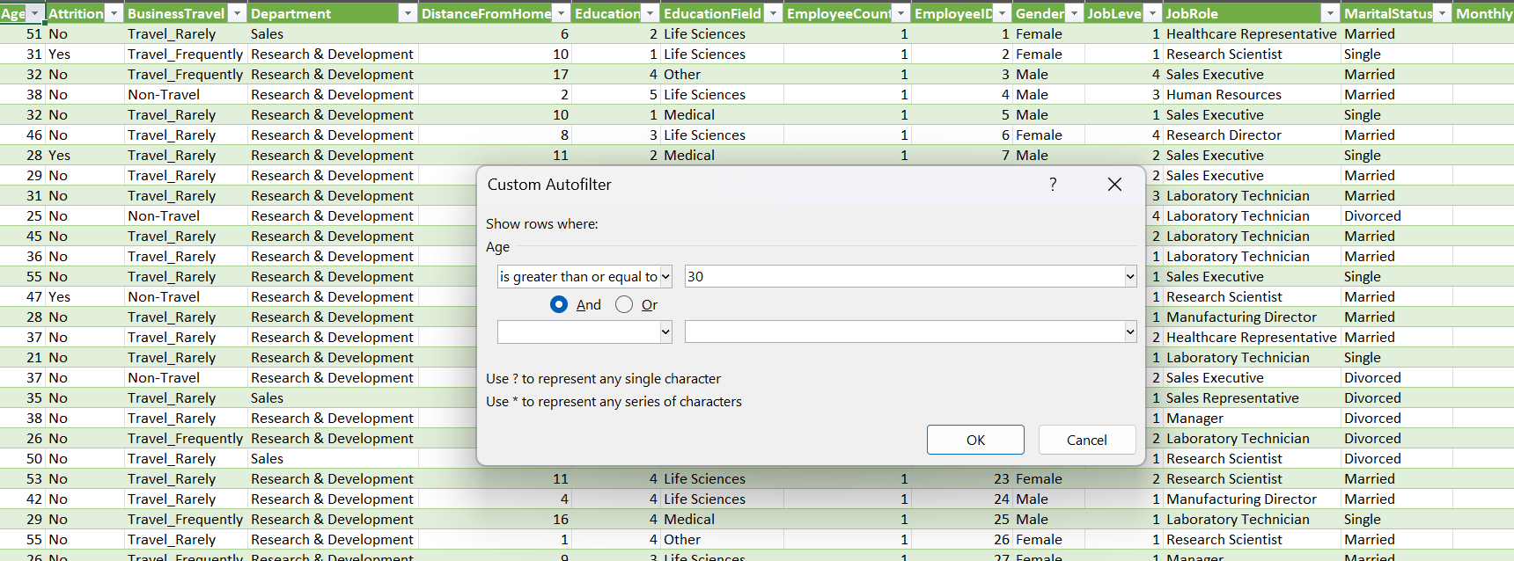
1- Using Excel, how would you filter the dataset to only show
employees aged 30 and above?

Slide 4
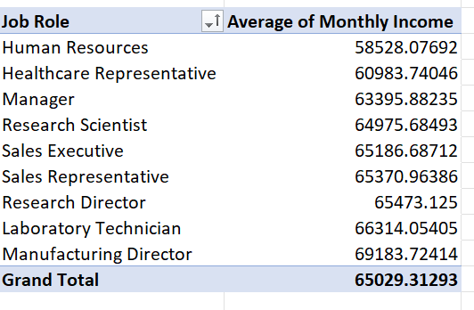
2- Create a pivot table to summarize the average monthly income
by Job Role.

Slide 5
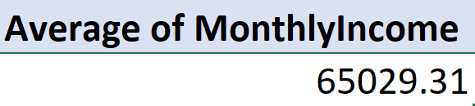
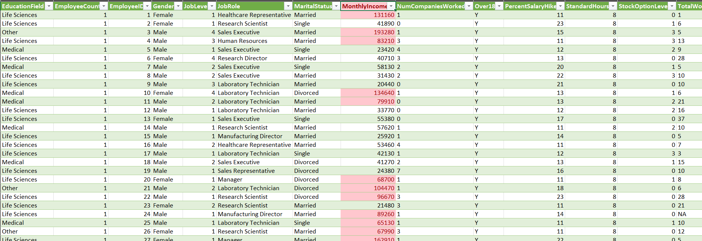
3- Apply conditional formatting to highlight employees with monthly income
above the company’s average income.

Slide 6
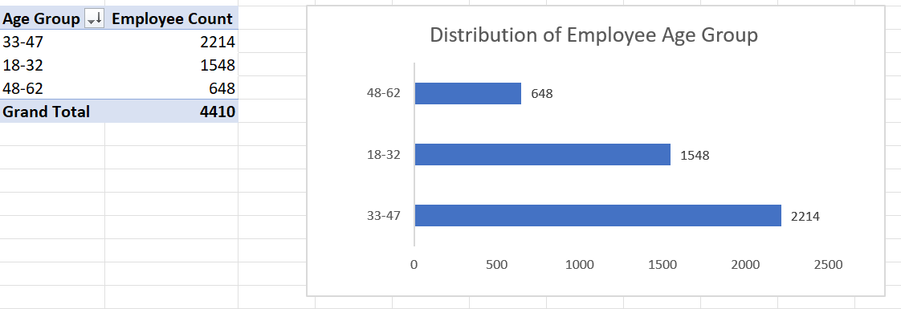
4- Create a bar chart in Excel to visualize the distribution of employee ages.

Slide 7
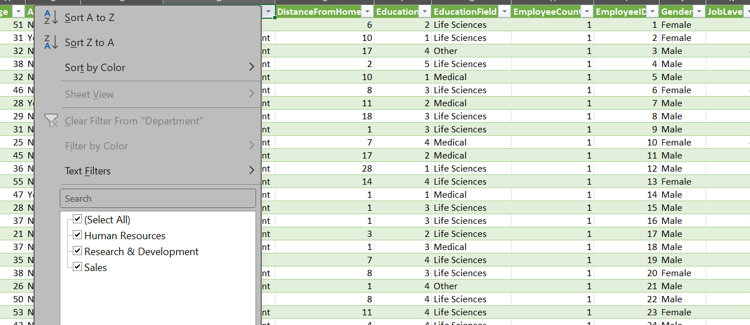
5- Identify and clean any missing or inconsistent data in the
“Department” column.
There is no any inconsistent data in the Department column

Slide 8
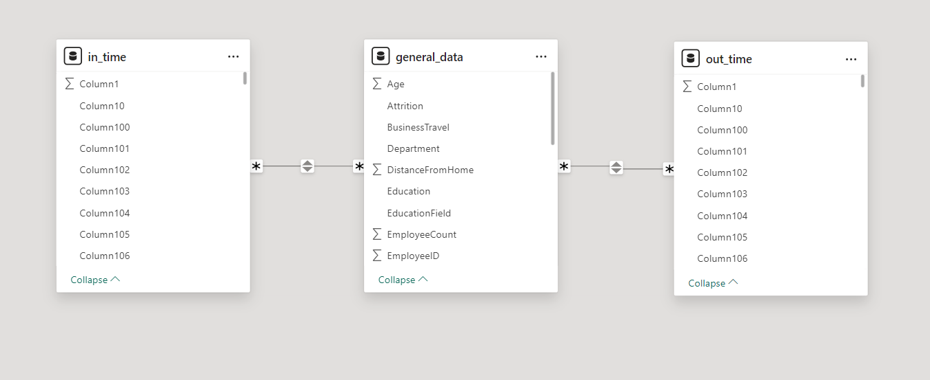
6- In Power Bi, establish a relation between the “Employee ID” in the employee
data and the “Employee ID” in the time tracking data.

Slide 9
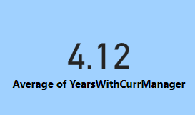
7- Using DAX, create a calculated column that calculates the average years
an employee has spent with their current manager.

Slide 10
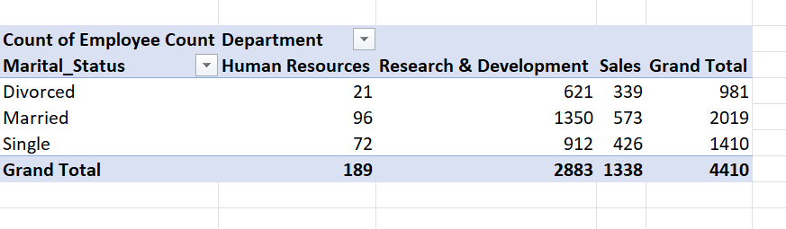
8- Using Excel, create a pivot table that displays the count of employees in
each Marital Status category, segmented by Department.

Slide 11
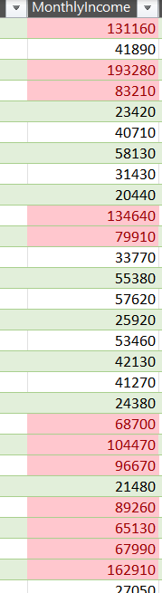
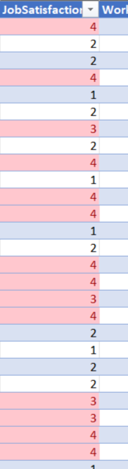
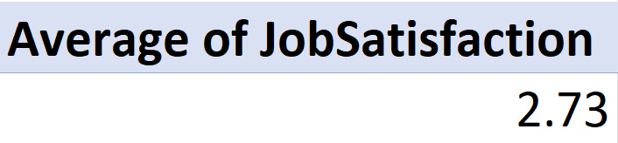
9- Apply conditional formatting to highlight employees with both above-average
Monthly Income and above-average Job Satisfaction.

Slide 12
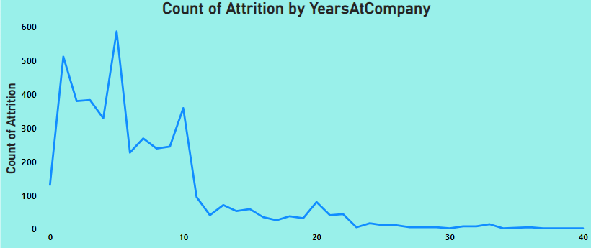
10- In Power BI, create a line chart that visualizes the trend of Employee
Attrition over the years.

Slide 13
11- Describe how you would create a star schema for this dataset, explaining
the benefits of doing so.
To create a star schema for this dataset:
Identify the Fact Table: Choose a central fact table containing HR metrices like Monthly Income,
Performance Rating, Job Satisfaction, etc.
Create Dimension Table: Design separate dimensions tables for attributes such as Employee ID,
Department, Job Role, etc.
Establish Relationships: Define the relationships between the fact table and dimension tables using
primary and foreign keys to link related data.
Optimizing Performance: Utilize star schema’s simplified structure to enhance query performance.
Enable Scalability and Analysis: Enjoy the benefits of scalability and streamlined analysis, allowing
for efficient reporting and adaptable data management as HR needs to evolve.

Slide 14
Benefits are:
Simplified Analysis: The star schema clear structure makes it easier to understand and analyse HR
data, facilitating efficient data exploration and interpretation.
Scalability: Star schema can easily accommodate new dimensions or measures as HR Data
requirements, evolve, ensuring flexibility and adaptability to changing business needs.
Improved Query Performance: With fewer tables and optimized relationships, star schemas typically
result in faster query execution, enabling quicker access to insights and analytics.
Enhanced Reporting: The organized nature of star schemas simplifies report generation, allowing
for comprehensive and insightful HR analytics report that support better decision making.
Data Integrity: By separating dimensions into individuals tables and establishing relationships with
the fact table, star schemas help maintain data integrity and consistency, ensuring relatable analysis
and reporting.

Slide 15
12- Using DAX, calculate the rolling 3-month average of Monthly Income for each
employee.
VAR Current Index = ‘general data’[Index1]
RETURN
AVERAGEX(
FILTER(
‘genera data’.
‘general data’[Index] <= Current Index &&
‘general data’[Index] >= Current Index – 2
),
‘general data’[Monthly Income]
)

Slide 16
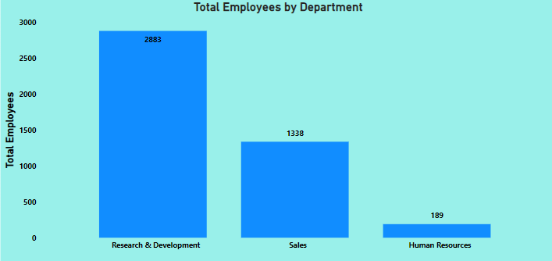
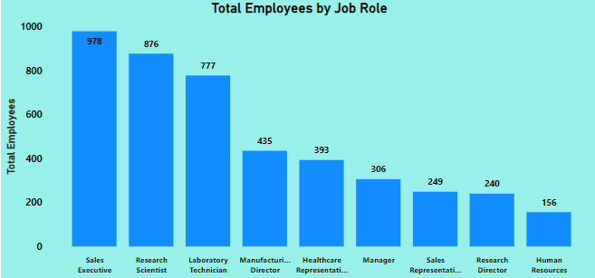
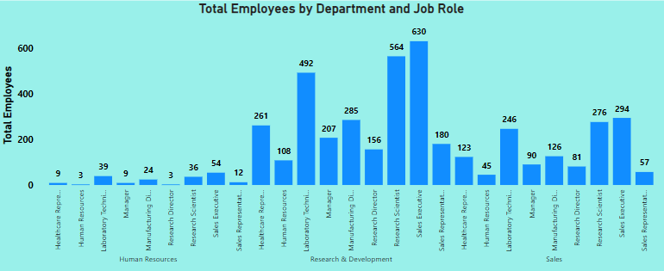
13- Create a hierarchy in Power BI that allows users to drill down from Department
to Job Role to further narrow their analysis.

Slide 17

14- How can you set up parameterized queries in Power BI to allow
users to filter data based on the Distance from Home column?
1- Open Query Editor: Access Power BI’s Query Editor.
2- Create Parameters: Make two parameters for Minimum and Maximum Distance values.
3- Filter Data: Set up a filter for the Distance from Home column using the parameters for
the range.
4- Apply Changes: Confirm the filter setting and apply them.
5- Use Parameters: Now adjust the parameters to dynamically filter the data based on
Distance from Home.

Slide 18
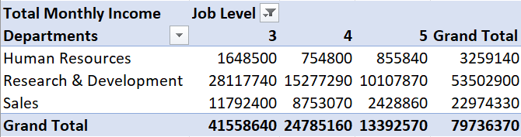
15- In Excel, calculate the total Monthly Income for each Department, considering
only the employees with a Job Level greater than or equal to 3.

Slide 19
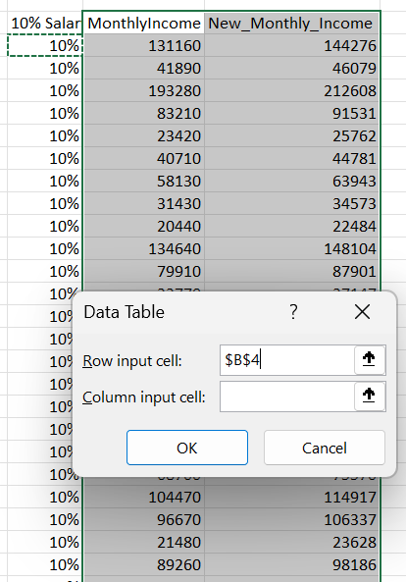
16- Explain how to perform a What-If analysis in Excel to understand the
impact of a 10% increase in Percent Salary Hike on Monthly Income.

Slide 20
17. Verify if the data adheres to a predefined schema. What actions would
you take if you find inconsistencies?
To verify if the data adheres to a predefined schema:
Review predefined schema: Ensure understanding of attribute names, types, and relationships.
Inspect data for inconsistencies: Utilize data profiling tools to identify disparities.
Identify missing or incorrect values: Scrutinize mandatory fields for completeness and accuracy.
Document issues and impact: Detail the significance of inconsistencies in analysis and decision-making
Cleanse, standardize, and enforce constraints: Rectify data anomalies and establish validation rules.
Communication findings to stakeholders: Foster collaboration by sharing insights with relevant
parties.
Implement ongoing monitoring for data quality: Set up regular audits to sustain high standards of
accuracy and reliability.

Slide 21
THANK YOU

